Slide 1
CELEBREMOS
- Lets Celebrate

Slide 2
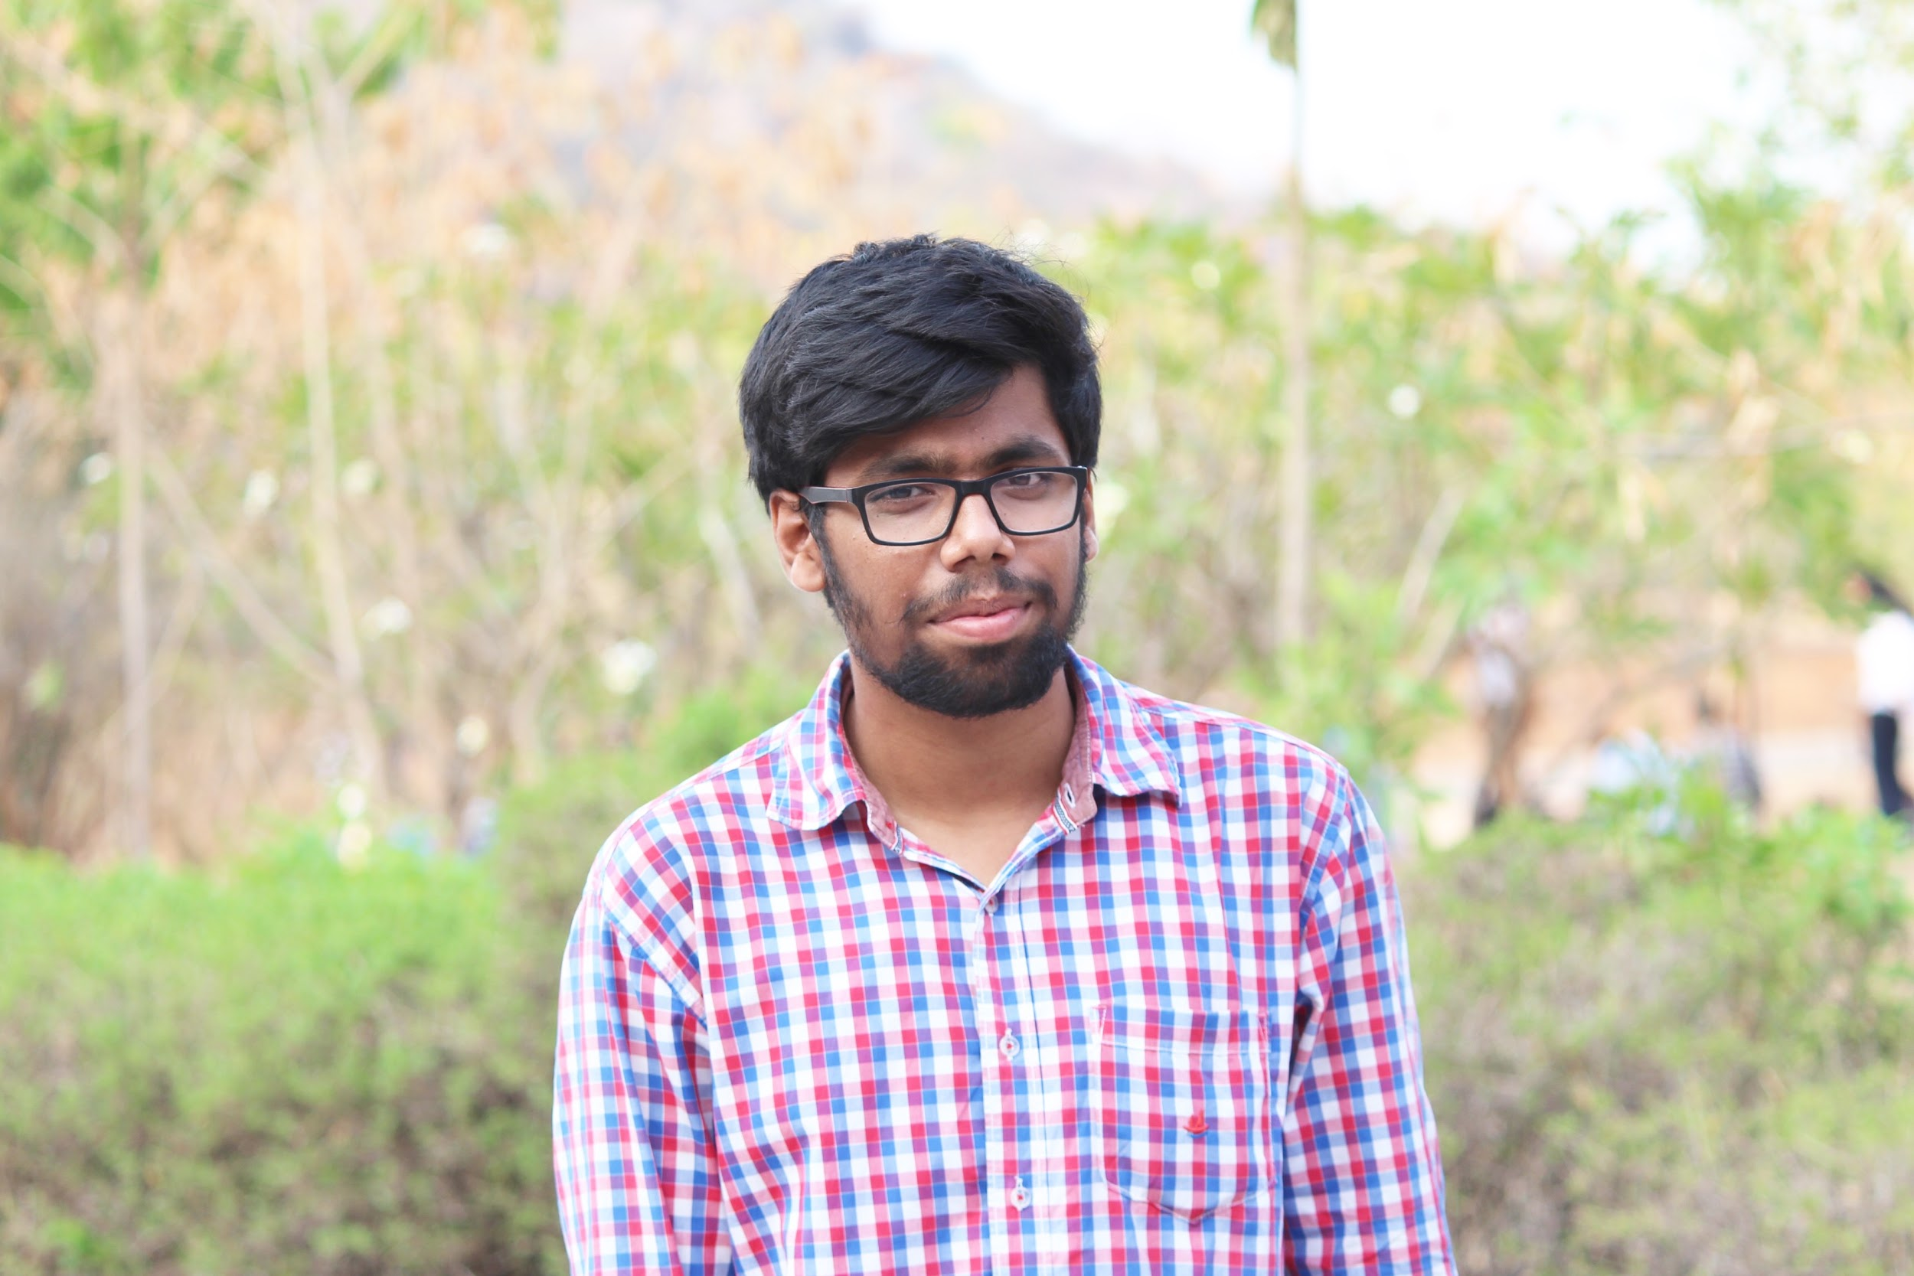
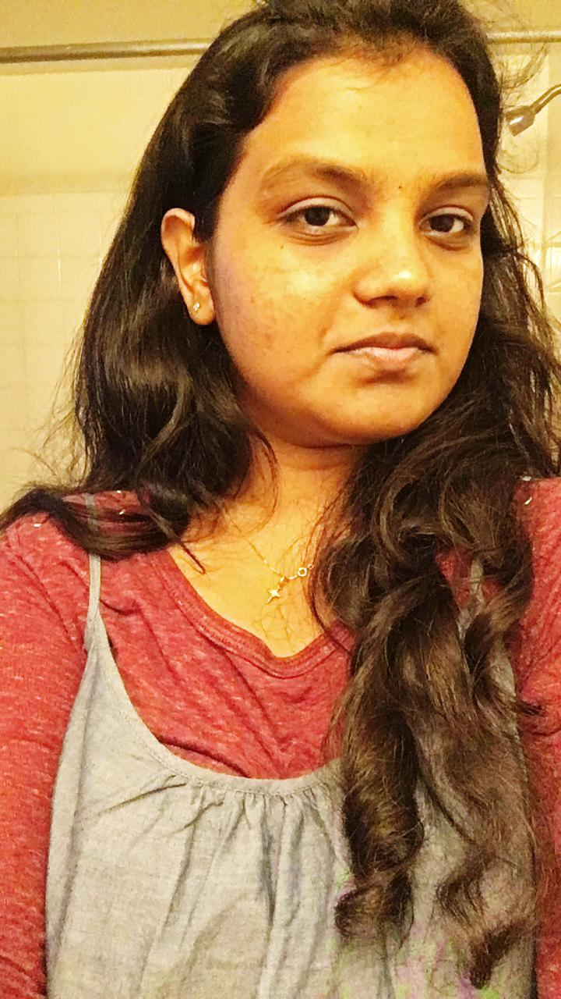
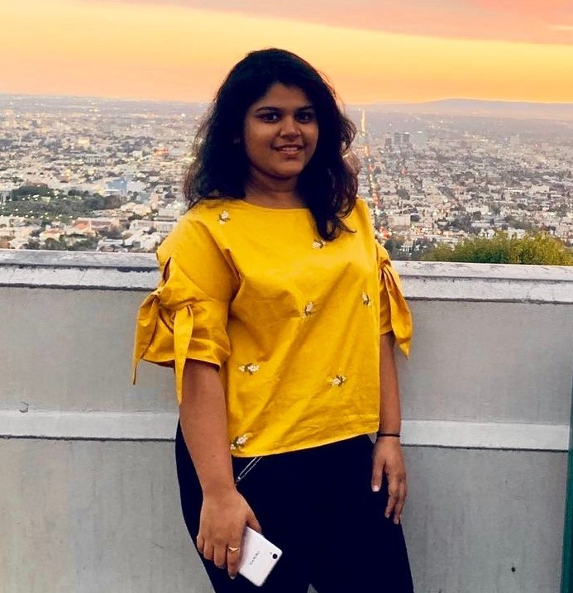
Team Members
Sairam Badisa
Hari Priya Jupally
Poojitha Singam

Slide 3

Outline
About the project
Project description
Requirements
Analysis
Design
Implementation
Summary
Sairam Badisa

Slide 4
CELEBREMOS
About the project:
Web project based on online invitation
Create a new Template or select one among invitations.
People can be invited to couple of events like
Marriage
Birthdays etc
Also can include couple of functionalities like
Number of guests
Conducting polls etc.
Sairam Badisa

Slide 5
CELEBREMOS
Project Description:
Celebremos helps to plan an event successfully.
Create, Modify and delete online invitation.
Focus on inviting guests
By sending mails or
Sending a text message to mobile.
Sairam Badisa

Slide 6
CELEBREMOS
Requirements:
Gathering requirements is one of the important phases.
Finding the entities.
Relationships between the entities.
Separate page for User and Guests.
Some of the Functionality Requirements are:
Creating Home Page, Login, Profile, Invitations etc.
Sairam Badisa

Slide 7
CELEBREMOS
User Login
User can register in the register page.
User is given an Email id and password to login.
Designing the invitation card.
Sending the invite.
Sairam Badisa

Slide 8
CELEBREMOS
Design:
Designing the UML Diagram.
Prototyping
Poojitha Singam

Slide 9
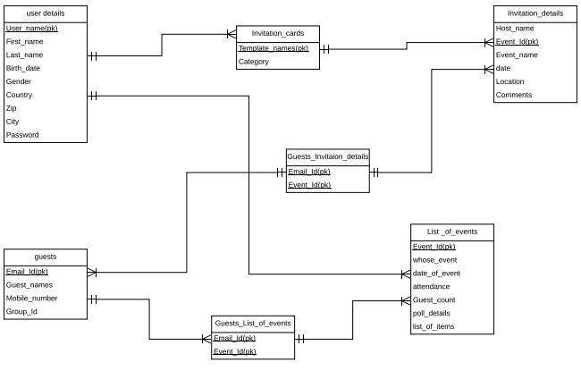
E-R Diagram
Poojitha Singam

Slide 10
CELEBREMOS
Analysis:
Only one event can be created at one time.
A person can create or can be invited to any number of events.
Create a group of people so that they can be called to other events.
Login Functionality by using sprint.
Poojitha Singam

Slide 11
CELEBREMOS
Implementation:
Using the Agile methodology we can gather the requirements.
We are using the Mongodb as a backend database.
Poojitha Singam

Slide 12
CELEBREMOS
Main Technologies which we use are:
MEAN ( Mongodb, Express, Angular, Node).
Html.
CSS and JavaScript.
Tools are:
Adobe Xd.
Lucid Chart.
Poojitha Singam

Slide 13

CELEBREMOS
A small demo on the prototype of our project.
Hari Priya Jupally

Slide 14
CELEBREMOS
Summary:
Any user who wants to create invitation must register.
By using this web application we can host an event successfully.
Anyone can have a great experience by using this application.
Hari Priya Jupally

Slide 15
Any Questions??
Sairam Badisa
Poojitha Singam
Hari Priya Jupally

Slide 16


